Slide 1




MTH208 COURSE PROJECT
GROUP - 18
AUTO-INSIGHTS
PROJECT ON CARS
DEVELOPERS
ASHISH KUMAR SONI
KHUSHI RANAWAT
BISHAL PAUL
JYOTISHKA PATRA

Slide 2


PROJECT OVERVIEW
TO DEVELOP A USER-FRIENDLY APP THAT PROVIDES ACTIONABLE INSIGHTS INTO CAR CHARACTERISTICS, HELPING USERS MAKE INFORMED CHOICES.
THE APP OFFERS FILTERING SELECTIONS BASED ON NEEDS, INDIVIDUAL CAR DETAILS, COMPARISON AND VISUALIZATION INSIGHTS

Slide 3
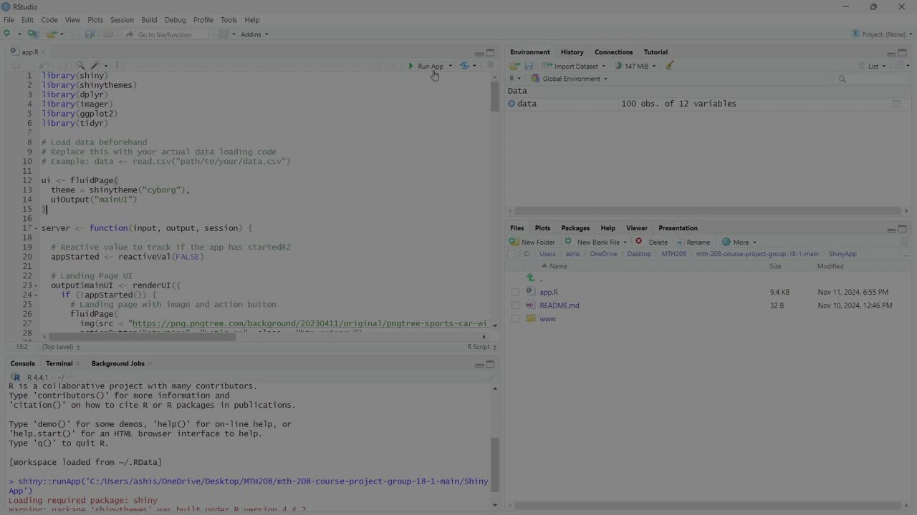

Slide 4
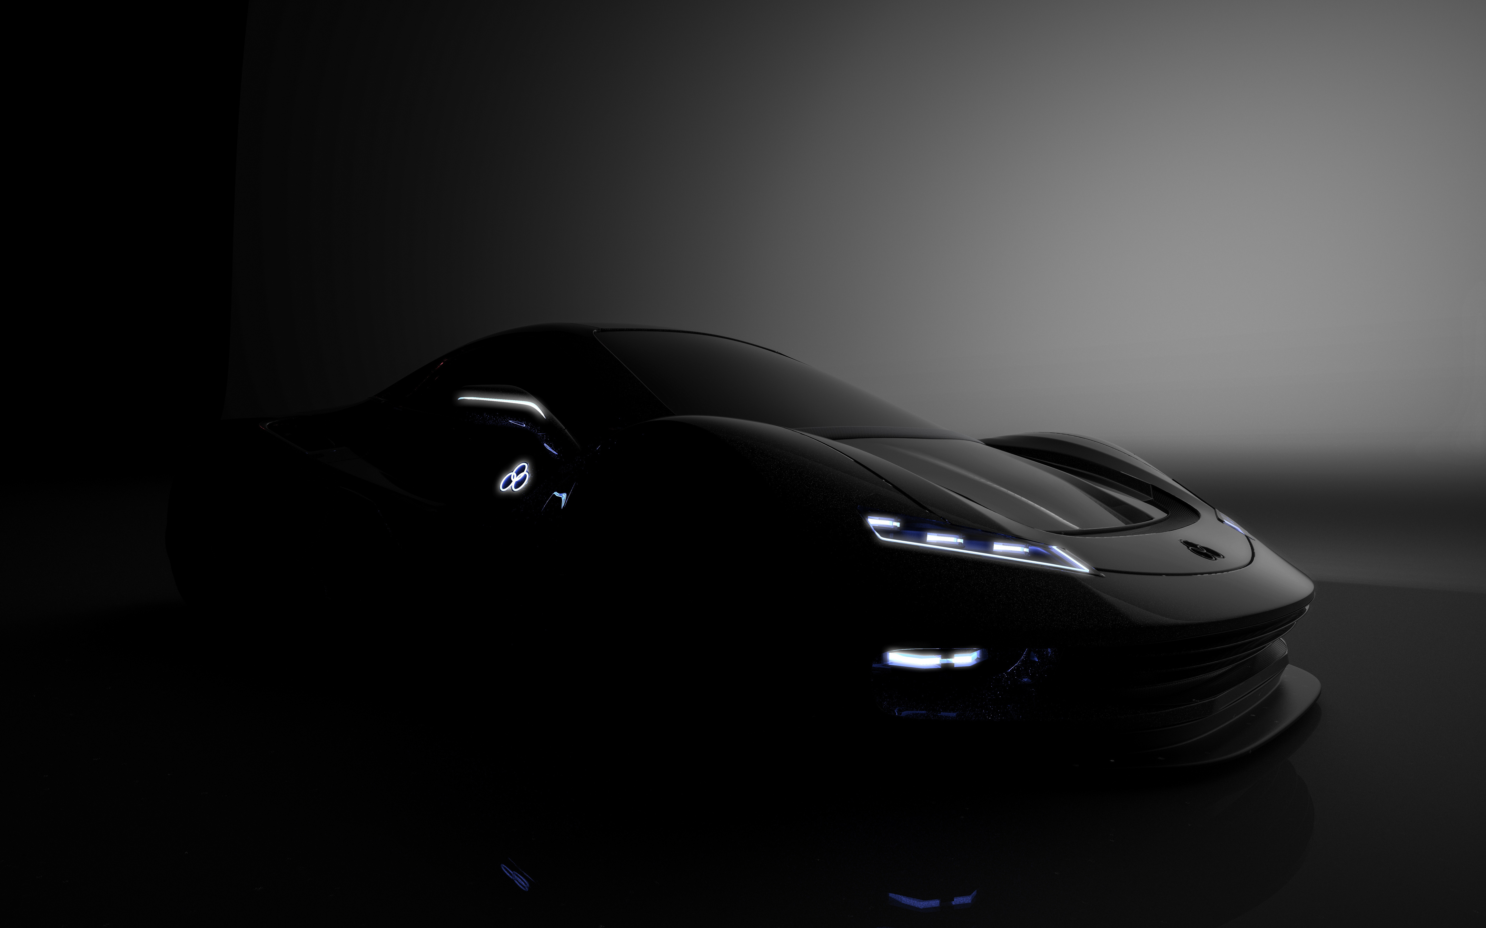
QUESTIONS WE AIM TO ANSWER VIA OUR APP
"WHAT ARE THE KEY FACTORS INFLUENCING CAR PRICES?"
"IS THERE A RELATIONSHIP BETWEEN CAR WEIGHT AND PERFORMANCE METRICS, SUCH AS TOP SPEED OR ACCELERATION?"
"HOW DO CARS FROM DIFFERENT REGIONS (E.G., EUROPE, ASIA) COMPARE IN TERMS OF AVERAGE PERFORMANCE METRICS AND PRICE?"

Slide 5
CHERRY ON THE CAKE
USER-FRIENDLY
ENGAGEMENT AND OPTIMIZATION
DECISION-MAKING ABILITY

Slide 6

GROUP 18
THANK YOU

